Slide 1


Slide 2


Extending the Blackbaud CRM UX using user interfaces and data from other systems
Wadih Pazos
Sr. Vice President
Product Development
PaperSave

Slide 3

Social Goodness
@Paperless_Post
Facebook.com/PaperSavePro
linkedin.com/in/wadihpazos
WPazos@PaperSave.com

Slide 4
Some techniques for integrating other UIs into CRM
Page Custom Actions
Page Tabs with Inline Frames
Custom Browser Extensions/Plugins

Slide 5


Page Custom Actions

Slide 6

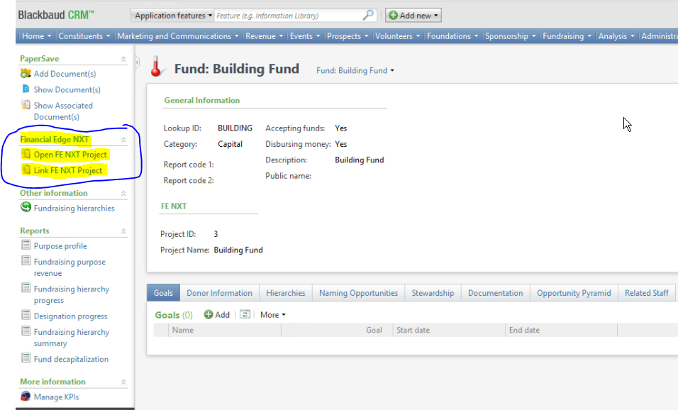
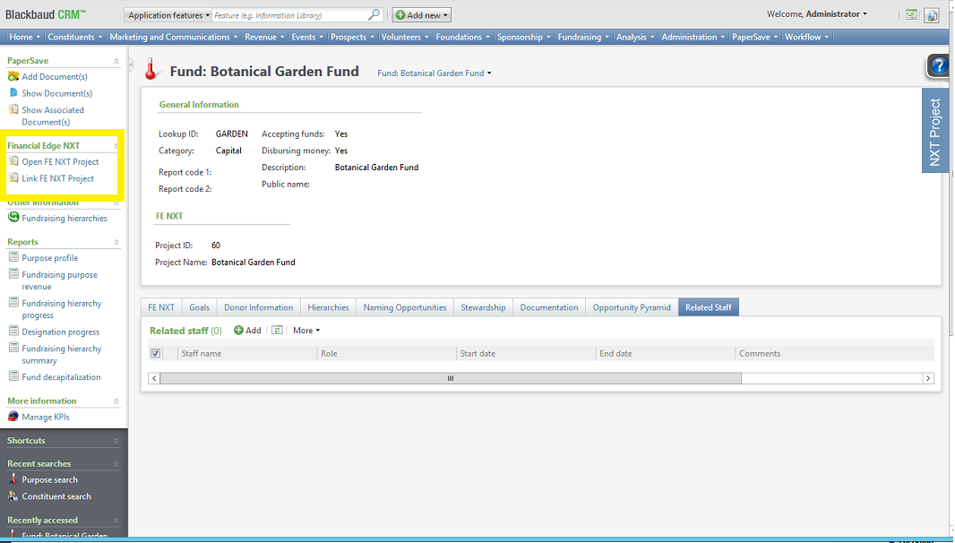

Slide 7
Upsides - Custom Page Actions
Actions appear in the CRM Entity Action Pane
Feel as if they are part of the Entities native options.
Can be defined for any CRM Entity (including default entities)
Allow for easy navigation and or popup pages.
Fully supported Infinity extensibility option

Slide 8
Downsides - Custom Page Actions
Does not have an integrated feel.
Cannot change the visual behavior of the action based on context.
Users have to click on the action to get a result.

Slide 9
Page Tabs with Inline Frames

Slide 10
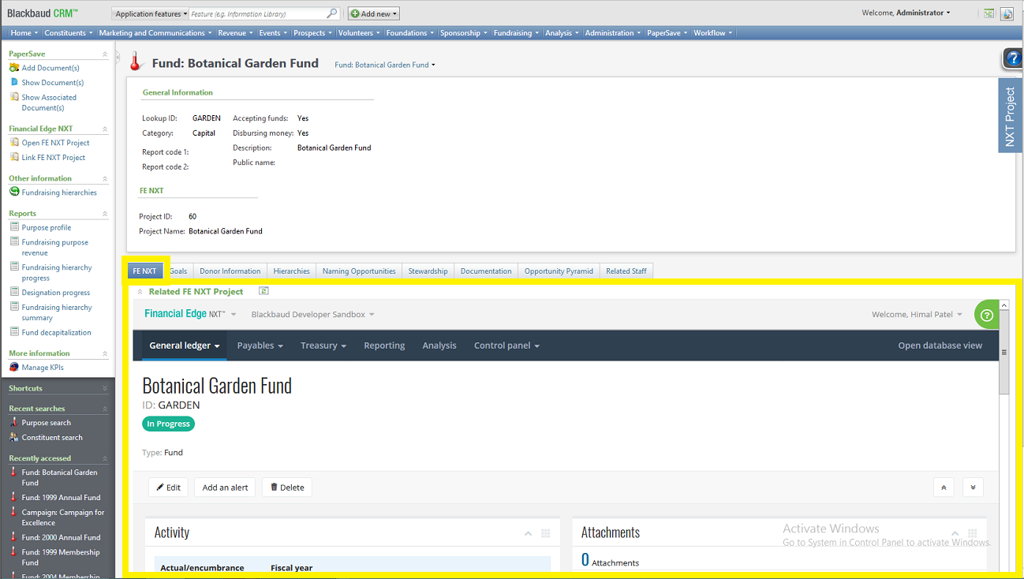
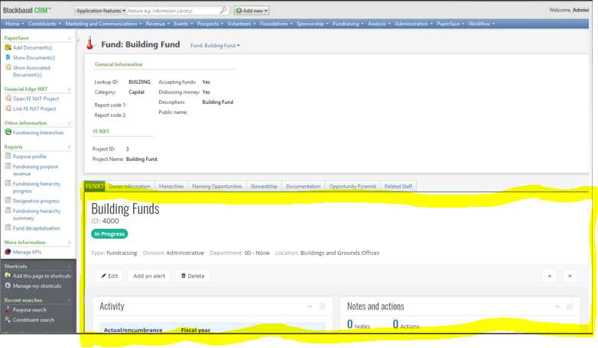
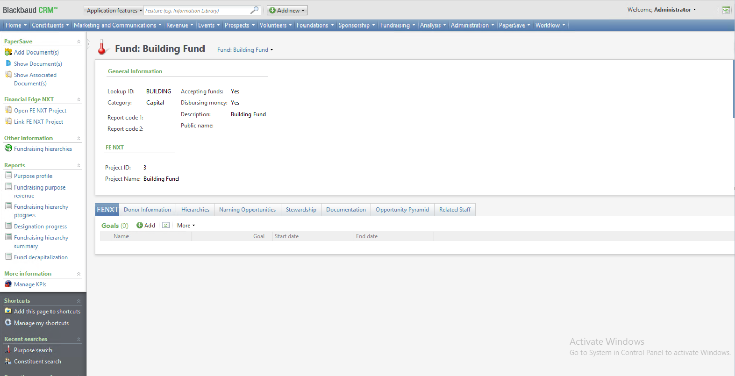
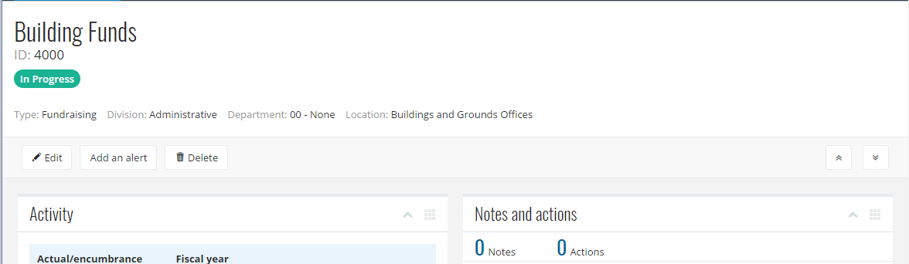

Slide 11
Upsides – Page Tabs with inline frames
Feel very integrated into the CRM Page
Allow you to display any inline frame within the Page tab
Total control of the user experience within the tab when using an inline frame
Fully supported Infinity extensibility option

Slide 12
Downsides - Page Tabs with inline frames
There is no direct way to pass context from the parent CRM page to the tab page’s inline frame.
The inline frame cannot access the parent page
Some web apps (such as FE/RE NXT) do not allow themselves to be rendered as inline frames

Slide 13
Custom Browser Extensions/Plugins

Slide 14
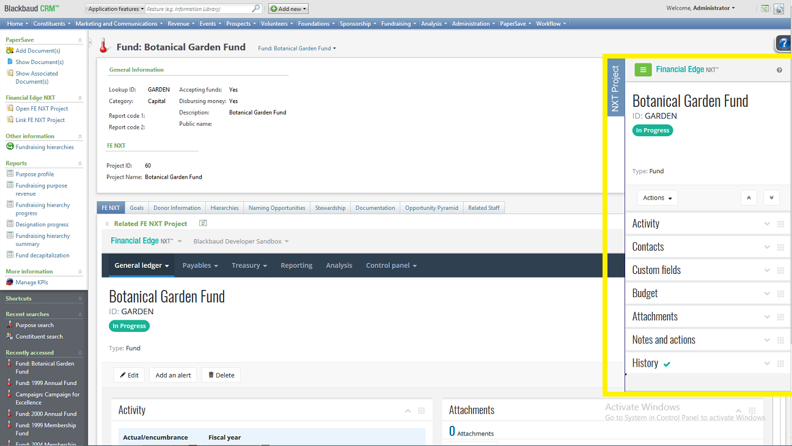

Slide 15
Upsides – Custom Browser Extensions/Plugins
Can be made to feel very integrated into CRM
Allows for complete DOM manipulation of the page. Endless possibilities.
Helps you get around limitations in the Infinity SDK

Slide 16
Downsides - Custom Browser Extensions/Plugins
Not a supported Infinity extensibility option
Each user has to install the browser extension. This complicates the delivery of the solution. Especially for IE and Edge. Easier in Firefox. Easiest in Chrome.
If the solution relies on DOM manipulation then it may be brittle. Changes to the page and or URL scheme may break the solution.

Slide 17
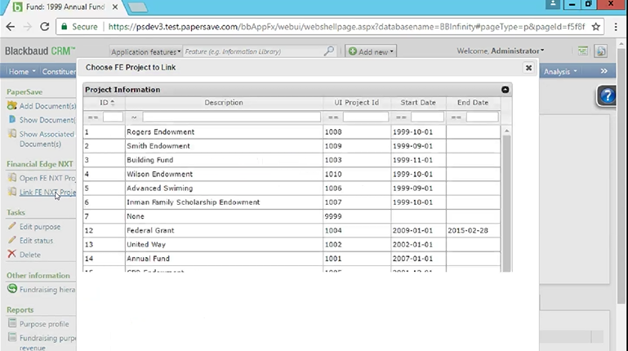
Demo

Slide 18
PaperSave – How have we taken advantage of
these approaches?

Slide 19
PaperSave Integrations
We use Page Custom Actions for adding/viewing documents related to an entity
We modify the navigation bar and add some PaperSave specific functions to launch out to our integration
We add a custom ribbon bar in batch to launch a data form for adding/viewing document related to a row
We use a browser extension to enhance the batch integration to reduce number of clicks.

Slide 20
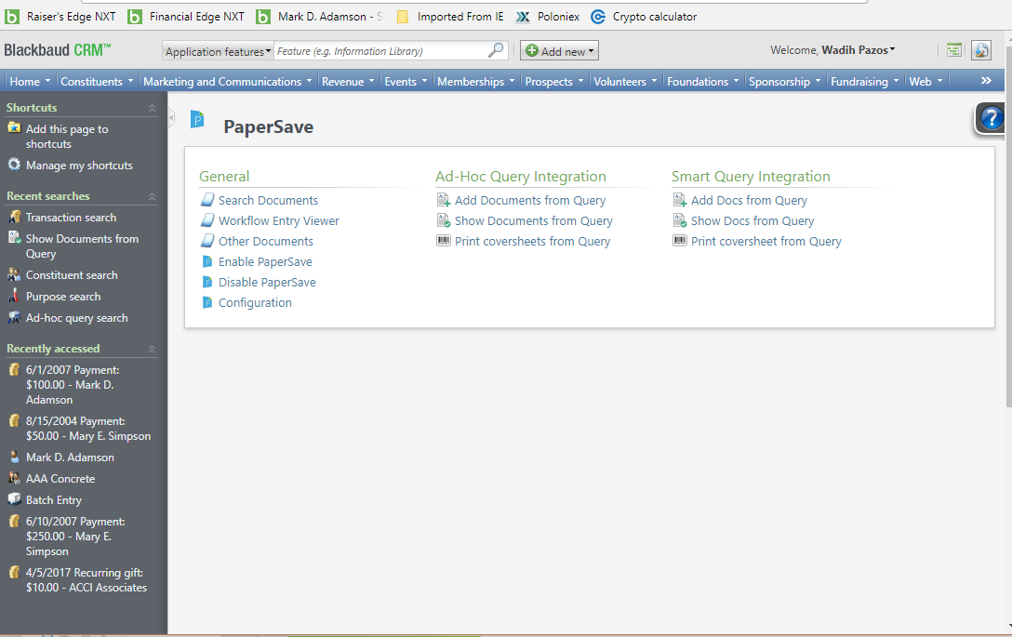
Demo

Slide 21

Download Sample Code
http://downloads2.papersave.com/files/productteam/wadih/blackbaud/bbcrmfenxtintegrationsample.zip

Slide 22
Social Goodness
@Paperless_Post
Facebook.com/PaperSavePro
linkedin.com/in/wadihpazos
WPazos@PaperSave.com

Slide 23


Questions?

